Slide 1
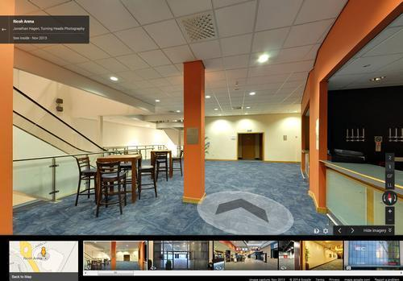
AUGMENTED REALITY INDOOR NAVIGATION APP
TEAM BLUEPRINTS
Justus Karenzi
Sudi Nsengiyumva
Jeremy Fischer
Jordan Ziegler
Dylan Shanahan

Slide 2


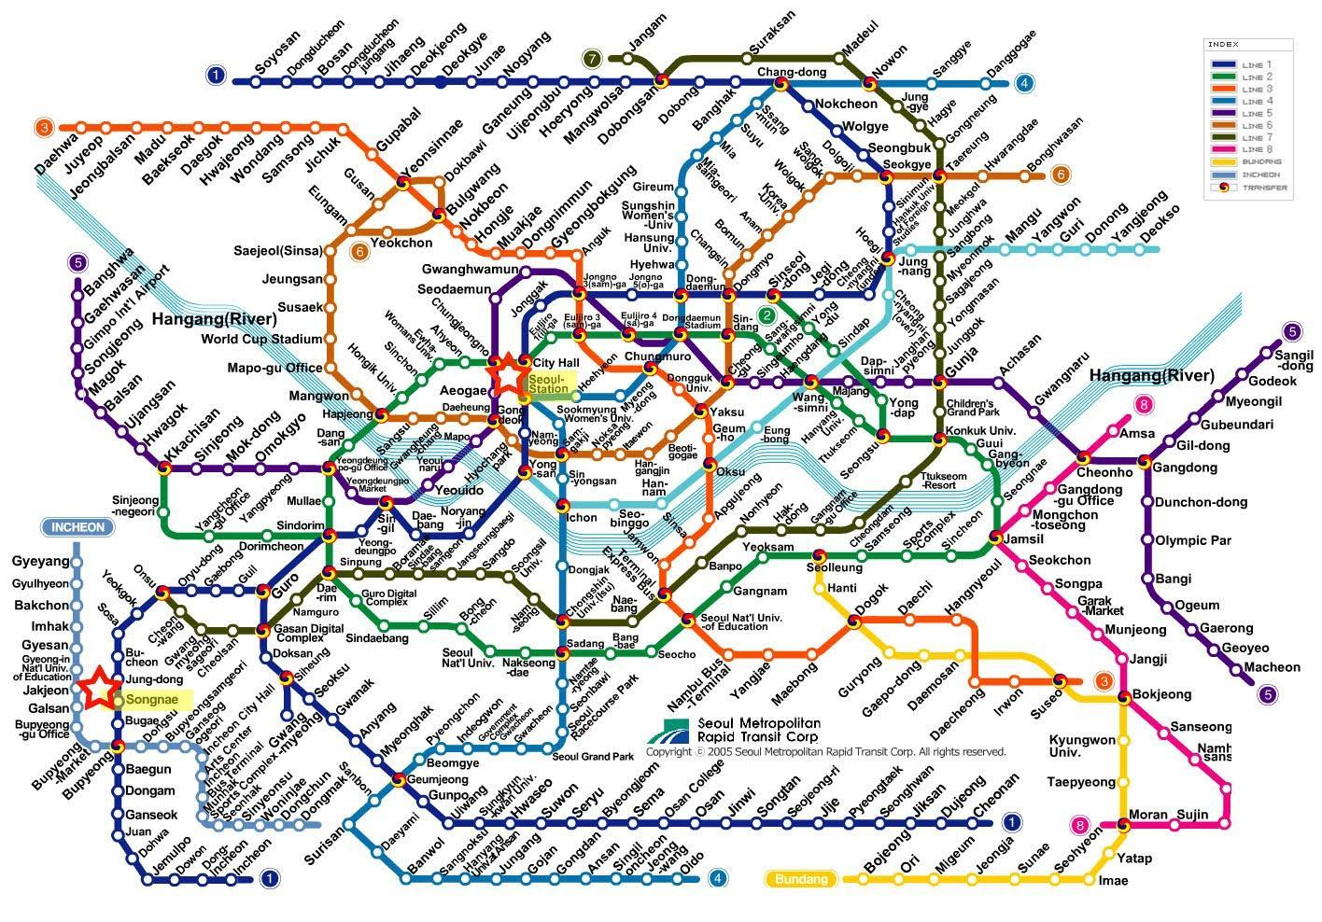
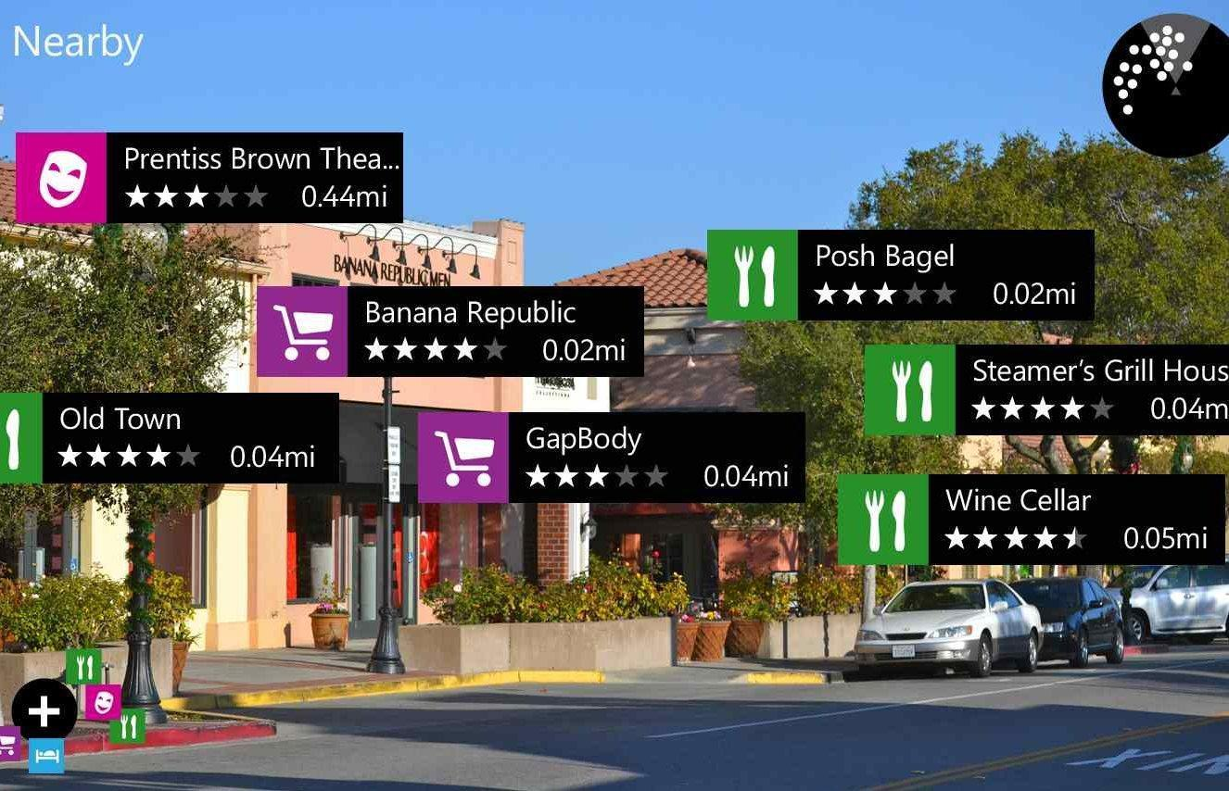
PROBLEM DEFINITION

Slide 3
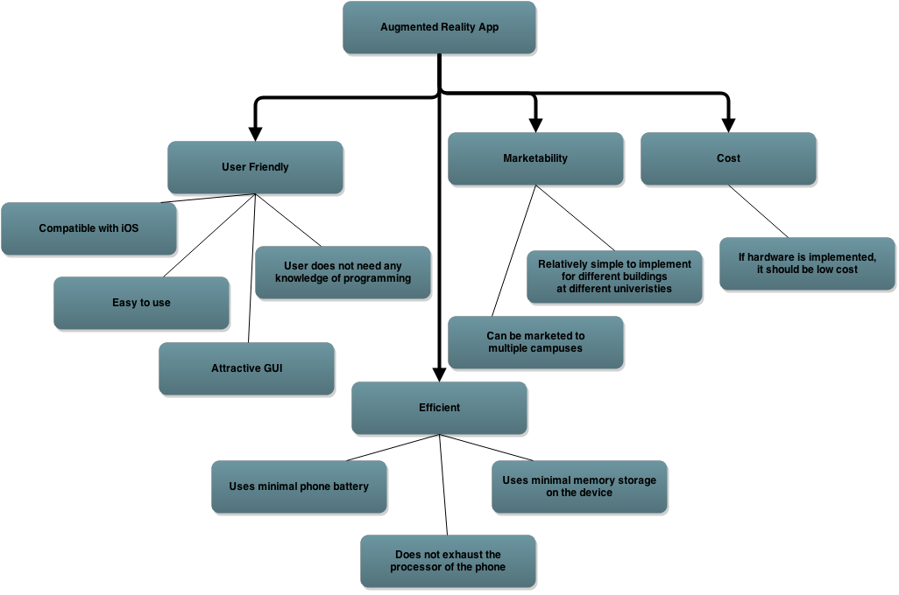
OBJECTIVES TREE

Slide 4
Efficiency plays a key role in the user experience.
Battery Life
Memory Storage
Processor Allocation

Slide 5


Time and budget constraints are also a factor.
Project Completion required by April 15 2015.

Slide 6
Software constraints are the main requirements of the project
Drop Down menu
CSV files
Left, right, straight direction
Image referencing
Starting Location

Slide 7
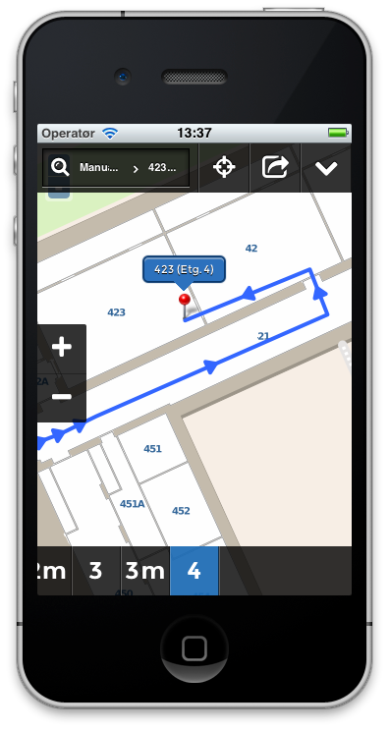
Also optional software requirements
Map Reference
Schedule implementation

Slide 8


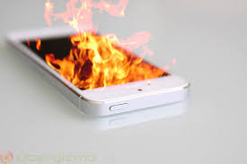
MARKETING REQUIREMENTS
1. The program should show users where they need to go.
2. The program should be user friendly and easily operated.
3. The program should not strain the user’s hardware.
4. Optional functionality
User Friendly.
Provides directions.
Does not strain hardware.

Slide 9

Concept Generation and Selection.

Slide 10

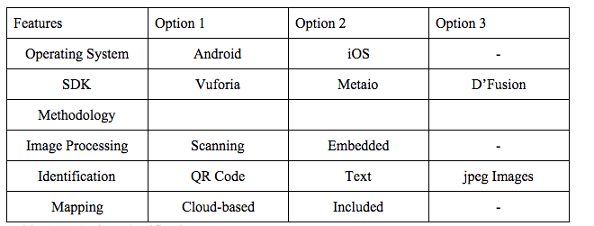
Concept Generation Chart
SDK | Vuforia | Metaio | D’Fusion
Brainstorming portion of the project

Slide 11
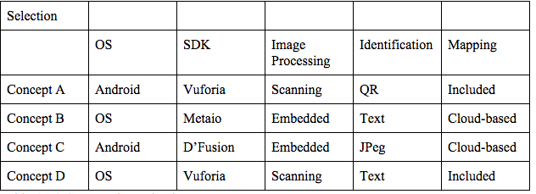

We combined the options brainstormed in different ways to generate concept ideas.

Slide 12
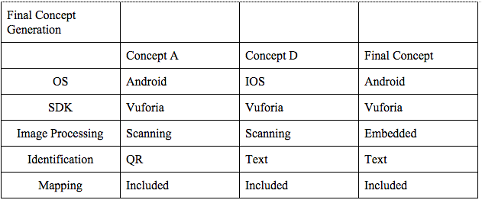
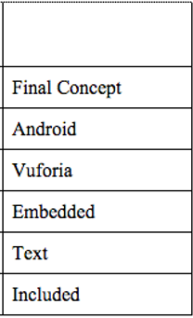
We generated a final concept based on a combination of two different designs.

Slide 13
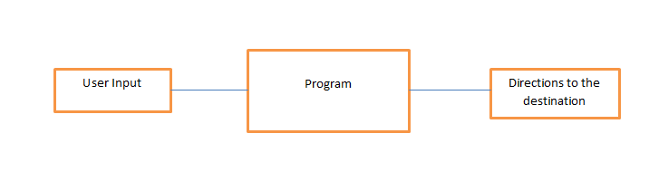
For the overall architecture we started with a Level 0 Model.
Figure 5.1.1 - Level 0 Software Architecture Design
Detailed Architecture

Slide 14
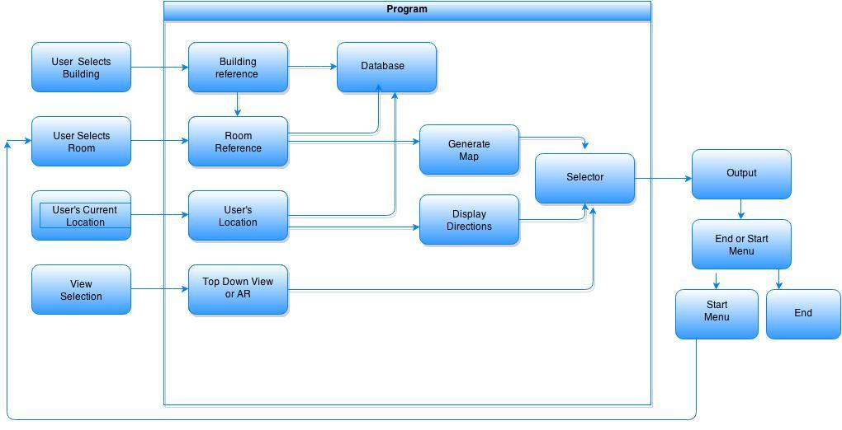
We expanded on our Level 0 Model to create a Level 1 module.
Figure 5.1.2 - Level 1 Software Architecture Design
Detailed Architecture

Slide 15
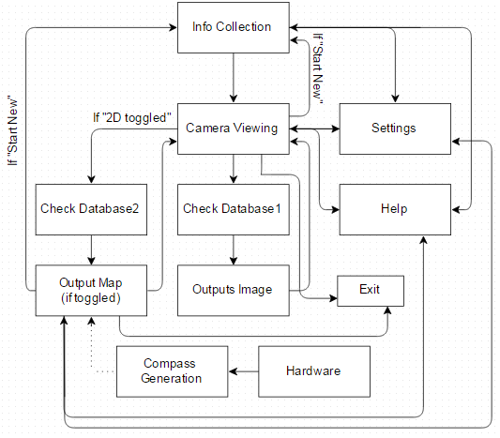
Finally, we created a Flow Chart to conceptually show how the App works.
Figure 5.2.1 - Augmented Reality App Flow Chart

Slide 16
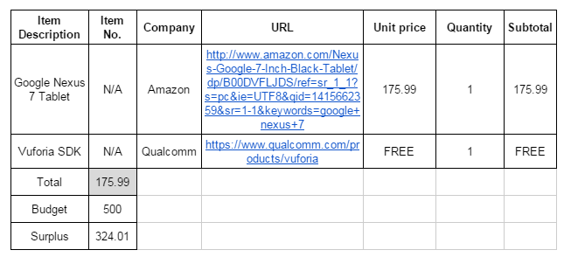
We created a Bill of Materials (BOM) to get an idea of the budget.
Table 5.13: Capital Equipment - Bill of Materials (BOM)
Detailed Budget

Slide 17
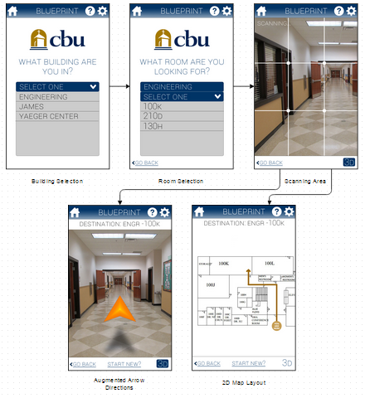
User Interface Flow Diagram

Slide 18
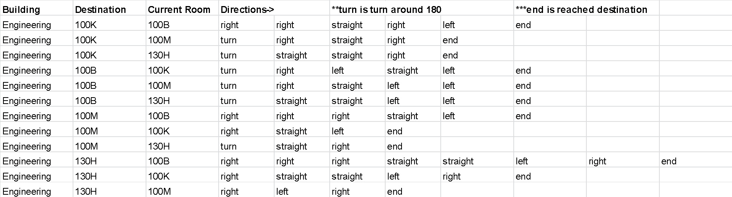
Database Design (.CSV File)

Slide 19
Current Status of Design
Currently, we have a dynamic user interface that can switch from one page to another.
In the process of trying to integrate text recognition with Android Studio using Unity
We are working on making the app interface with the designed database file (which contains directions and room numbers).
We were able to implement a class that integrates the device’s camera feature in the app.

Slide 20
Now we will jump to Android Studio to demonstrate our prototype.

Slide 21
QUESTIONS?

